Slide 1
Sentiment Analysis With Python
Leyla Abdullayeva - 1904010038

Slide 2
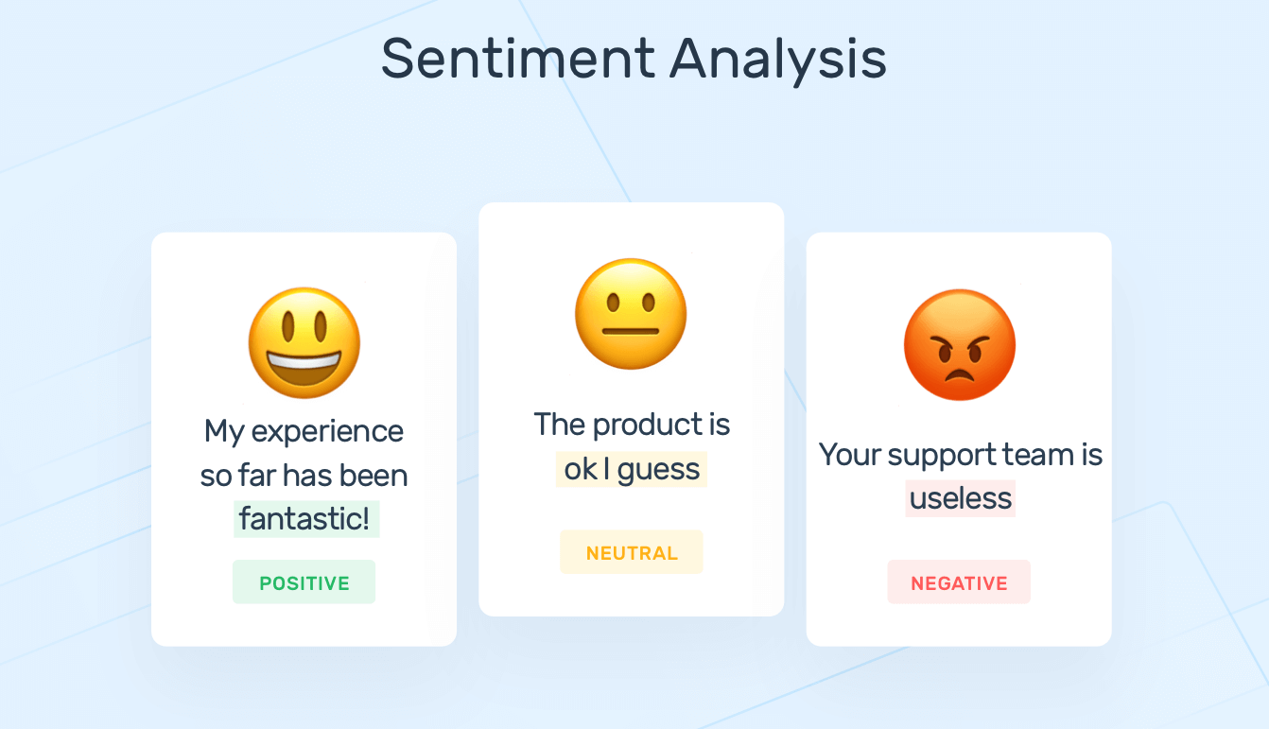
What is Sentiment Analysis?
Notes:
Sentiment Analysis with Python is the process of utilizing Python programming language and natural language processing techniques to analyze and determine the emotional tone, opinions, or sentiments expressed in textual data, such as reviews, comments, or social media posts. It’s the process of ‘computationally’ determining whether a piece of writing is positive, negative or neutral. It’s also known as opinion mining, deriving the opinion or attitude of a speaker

Slide 3
Python Libraries That I used
Pandas
Preprocess_kgptalkie
NLTK
Matplotlib
Seaborn
Faker
Sklearn
Notes:
Pandas: Pandas is a powerful Python library for data manipulation and analysis, providing easy-to-use data structures like data frames for handling and exploring structured data.
Preprocess_kgptalkie: Preprocess_kgptalkie is a library designed for text preprocessing in NLP projects, offering tools for cleaning and preparing textual data for analysis.
NLTK (Natural Language Toolkit): NLTK is a comprehensive library for natural language processing, offering tools for tokenization, stemming, tagging, parsing, and sentiment analysis.
Matplotlib: Matplotlib is a widely-used Python plotting library that enables the creation of static, animated, and interactive visualizations for data exploration and presentation.
Seaborn: Seaborn is a data visualization library based on Matplotlib, providing a high-level interface for creating informative and aesthetically pleasing statistical graphics.
Faker: Faker is a library for generating fake data, such as names, addresses, and dates, which is useful for testing, prototyping, and anonymizing datasets.
Scikit-learn (Sklearn): Scikit-learn is a machine learning library that offers simple and efficient tools for data analysis and modeling, including algorithms for classification, regression, clustering, and more.

Slide 4
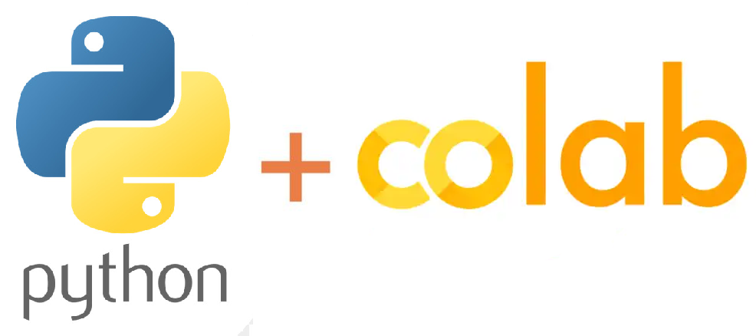
Google Colab
Notes:
Google Colab is a cloud-based platform that provides a free, collaborative, and accessible environment for writing and executing Python code, particularly well-suited for machine learning and data analysis tasks.

Slide 5
Algorithms that I’ve used
Random Forest Classifier
NLTK
NAİVE BAYES
Support Vector Machine Algorithm (SVM)
Notes:
These supervised learning algorithms serve distinct purposes: Random Forest Classifier is an ensemble learning method that builds multiple decision trees; NLTK (Natural Language Toolkit) is a versatile Python library for natural language processing; Naive Bayes is a probabilistic algorithm based on Bayes' theorem often used for classification; and Support Vector Machine (SVM) is a powerful algorithm for defining hyperplanes that separate data points into distinct classes.

Slide 6
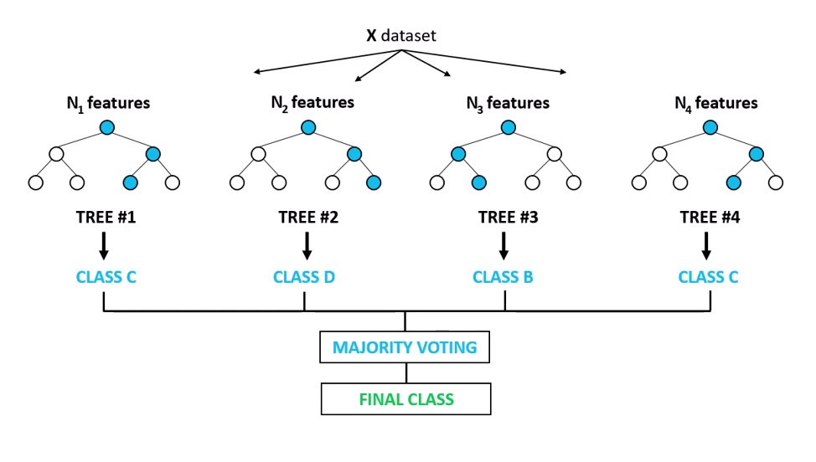
RANDOM FOREST CLASSIFIER
Notes:
Random Forest Classifier: Random Forest Classifier is an ensemble learning algorithm that constructs multiple decision trees during training and outputs the mode of the classes for classification.

Slide 7
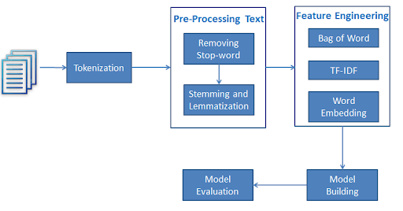
NLTK
Notes:
NLTK (Natural Language Toolkit): NLTK is a powerful Python library for natural language processing, offering tools and resources for tasks such as tokenization, stemming, and sentiment analysis.

Slide 8
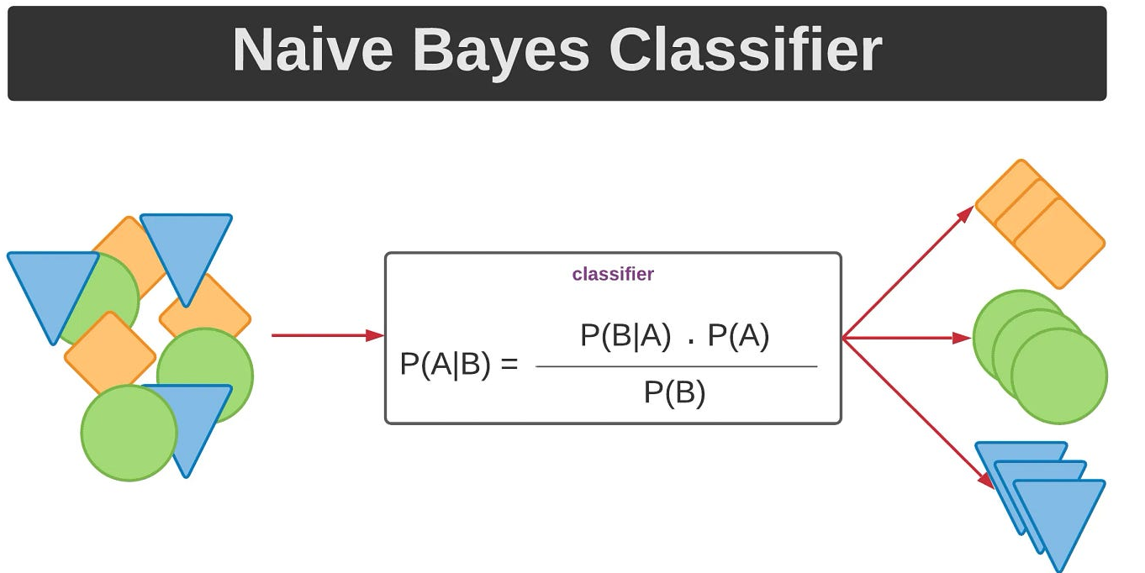
NAİVE BAYES
Notes:
Naive Bayes: Naive Bayes is a probabilistic machine learning algorithm based on Bayes' theorem, often used for classification tasks by assuming independence between features.

Slide 9
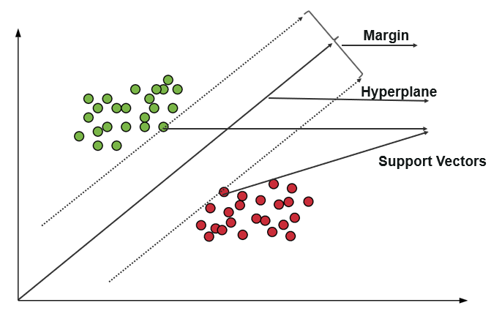
Support Vector Machine Algorithm (SVM)
Notes:
Support Vector Machine (SVM): Support Vector Machine is a supervised machine learning algorithm that finds the optimal hyperplane to separate classes in a dataset, making it effective for classification tasks.

Slide 10
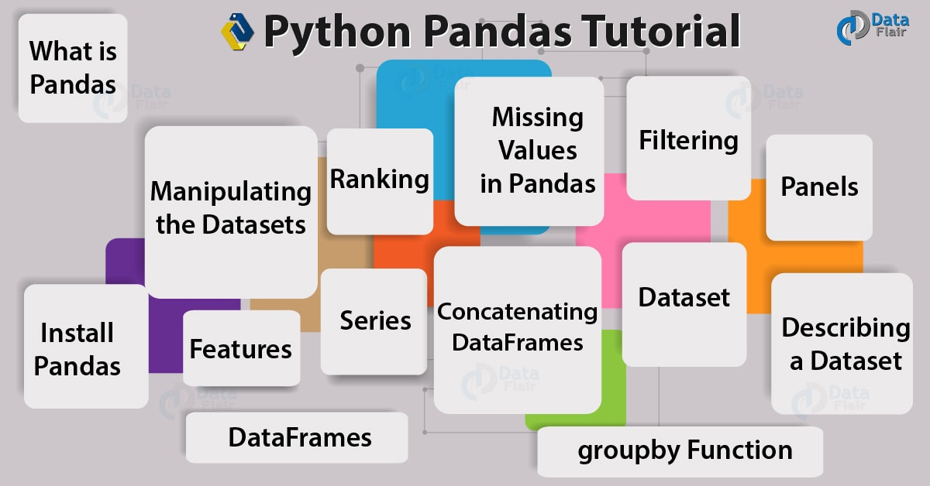
PANDAS
Notes:
Pandas is a Python library for data manipulation and analysis that provides data structures like data frames to efficiently handle and explore structured data.

Slide 11

Visualizations (Matplotlib + Seaborn)
Notes:
Matplotlib is a widely-used Python library for creating static, animated, and interactive visualizations, while Seaborn is a data visualization library based on Matplotlib, providing a high-level interface for creating informative and aesthetically pleasing statistical graphics.

Slide 12

Faker
Notes:
Faker is a Python library for generating fake data, such as names, addresses, and dates, useful for testing, prototyping, and anonymizing datasets.

Slide 13
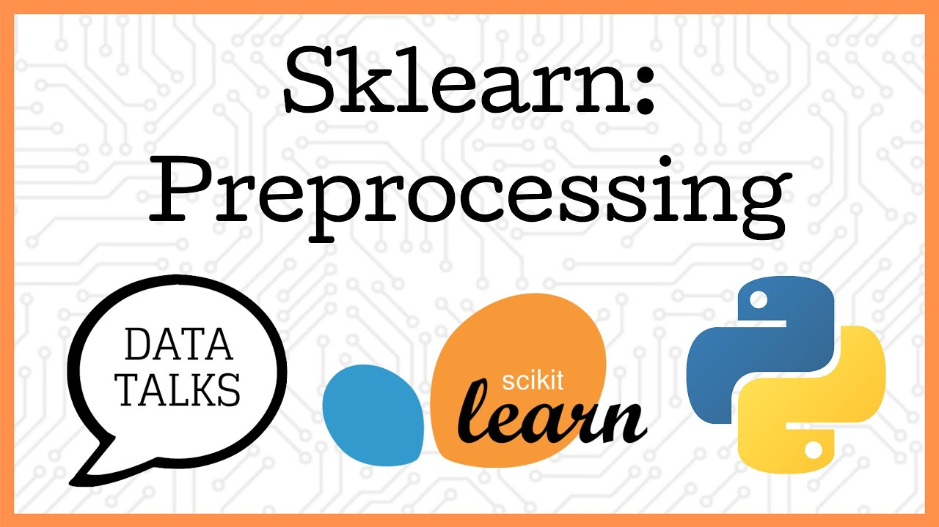
Sklearn
Notes:
Scikit-learn (Sklearn) is a Python library for machine learning that provides simple and efficient tools for data analysis and modeling, including various algorithms for classification, regression, clustering, and more.

Slide 14
Future Use
İntegrating trained “Amazon” dataset -
https://www.kaggle.com/datasets/bittlingmayer/amazonreviews
Logistic Regression algorithm can be used and integrated.
Neural Networks can be used with our trained datasets.

Slide 15
THANKS FOR LİSTENİNG !

